Slide 1


General properties of viruses
Lecture 7
Prof. Dr. Munira Ch. Ismaeel
Ass. Prof. Dr. Israa AJ Ibrahim

Slide 2

General properties of viruses Lec 7
Prof. Dr. Munira Ch. Ismaeel and Ass. Prof. Dr. Israa AJ Ibrahim

Slide 3
History of virus
In the year 1897, a scientist named Beijerinck discovered and coined the term virus. The term virus is derived from Latin word-“virus” means poison. Later in the year 1935, a scientist named Wendell Stanley discovered that these viruses are composed of nucleic acids, protein and lips.

Slide 4
Properties of viruses
non-cellular organisms (or particle), which made up of genetic material and protein.
very small and they measured in nanometers. Their size ranges from 20nm up to 450nm (diameter).
inactive macromolecules outside the host and active only inside host cell.
obligate intracellular parasites.
infect all types of life forms such as: animal cell, plant cell, fungi and bacteria.
consist of nucleic acids DNA or RNA. Nucleic acid can be double-stranded DNA, single-stranded DNA, single-stranded RNA or double-stranded RNA.
have protein coat, called a capsid (no cell membrane).
Some viruses have an external covering called envelope
viruses are replicates only inside the living cells of other organisms.
lack enzymes for most metabolic processes.
lack machinery for synthesizing proteins.
Multiply by taking control of host cell's genetic material and regulating the synthesis and assembly of new viruses.

Slide 5
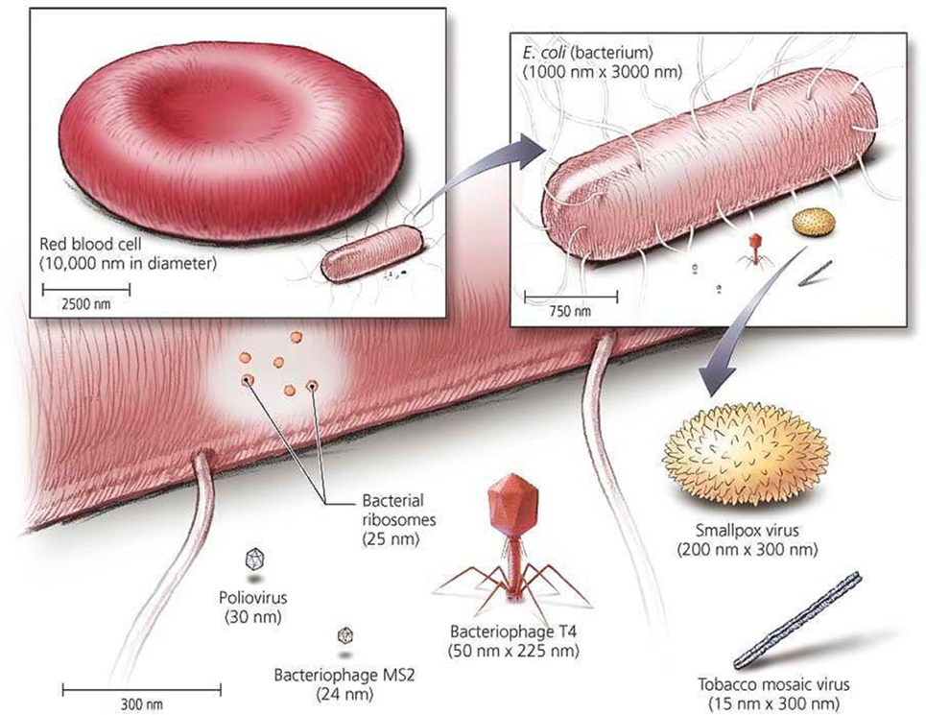
Viral Size
most <0.2 μm
requires electron microscope
must be smaller than the cells they infect
smaller than bacteria (E. coli 1000 x 3000nm)
too small to be seen by light microscopy

Slide 6
How viruses are classified?
Main criteria presently used are structure, chemical composition, and genetic makeup.
No taxa above Family (no kingdom, phylum, etc.)
Currently recognized: 3 orders, 63 families, and 263 genera of viruses
Family name ends in -viridae, i.e.Herpesviridae
Genus name ends in -virus, Simplexvirus
Herpes simplex virus I (HSV-I)

Slide 7
General Structure of Viruses
Capsids
-All viruses have capsids - protein coats that enclose and protect their nucleic acid.
-Each capsid is constructed from identical subunits called capsomers made of protein.
-The capsid together with the nucleic acid are nucleoscapsid.
-Some viruses have an external covering called envelope; those lacking an envelope are naked

Slide 8
There are 3 basic shapes based on how the capsomeres are arranged:
1- helical- continuous helix of capsomers forming a cylindrical nucleocapsid
2- polyhedral or icosahedral - 20-sided with 12 corners. Each capsomer may be made of 1 or several proteins.
3- complex- combination viruses with a helical portion (tail) attached to a polyhedral portion (head); ex. bacteriophages

Slide 9
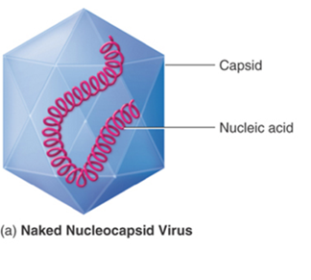
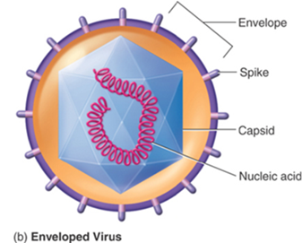
Virus structure

Slide 10
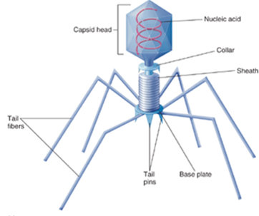
2- Envelope
Viral envelope properties are:
-mostly animal viruses
-acquired when the virus leaves the host cell
-exposed proteins on the outside of the envelope, called spikes, essential for attachment of the virus to the host cell.

Slide 11
Modes of Viral Multiplication
General phases in animal virus multiplication cycle:
1.Adsorption - binding of virus to specific molecule on host cell
2.Penetration - genome enters host cell
3.Uncoating – the viral nucleic acid is released from the capsid
4.Synthesis – viral components are produced
5.Assembly – new viral particles are constructed
6.Release – assembled viruses are released by budding (exocytosis) or cell lysis

Slide 12
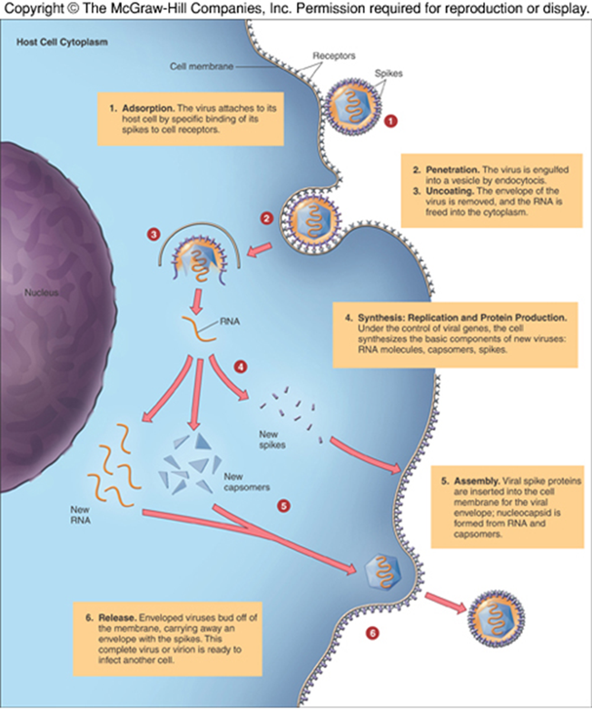
Example: life cycle

